Slide 1
PSYCHOLOGICAL DISORDERS
CLASS XII

Slide 2
HOW CAN YOU DIFFERENTIATE BETWEEN A NORMAL AND ABNORMAL BEHAVIOUR????

Slide 3
ABNORMAL BEHAVIOUR
ABNORMAL BEHAVIOUR MAY BE DEFINED AS A BEHAVIOUR THAT IS –
DISTURBING (socially unacceptable)
DISTRESSING
MALADAPTIVE ( self- defeating)
AND OFTEN THE RESULT IS DISTORTED THOUGHTS (cognition).

Slide 4
FOUR D’s
DANGER
DISTRESS
DYSFUNCTION
DEVIANCE
D’S

Slide 5
NORMAL BEHAVIOUR
NORMAL BEHAVIOUR IS SOICALLY ACCEPTABLE BEHAVIOUR.
THAT CONFORMS TO THE MOST COMMON BEHAVIOUR IN SOCIETY.
IT MAY VARY BY PERSON, TIME, PLACE AND SITUATIONS.
IT CHANGES ALONG WITH CHANGING SOCIETAL NORMS.

Slide 6
APPROACHES
THERE ARE TWO APPROACHES TO STUDY ABNORMAL BEHAVIOUR-
DEVIATION FROM SOIAL NORMS
MALADAPTIVE ( fosters the well-being of the individual)
STIGMA attached to mental illness means that people are hesitant to consult a doctor or psychologists as they are ashamed of their problems.

Slide 7
HISTORICAL BACKGROUND
SUPERNATURAL AND MAGICAL FORCES, EXORCISM.
BIOLOGICAL APPROACH ( body and brain are not working properly)
ORGANISMIC APPROACH ( conflicts between emotions and reasons)
MIDDLE AGE , demonology and superstitions gained renewed importance in explanation of abnormal behaviour.
RENAISSANCE PERIOD , Johann Weyer emphasised on psychological conflicts and disturbed inter-personal relationship.
17th and 18th centuries were known as AGE OF REASON AND ENLIGHTENMENT, REFORM MOVEMENT AND DEINSTITUTIONALISATION.

Slide 8
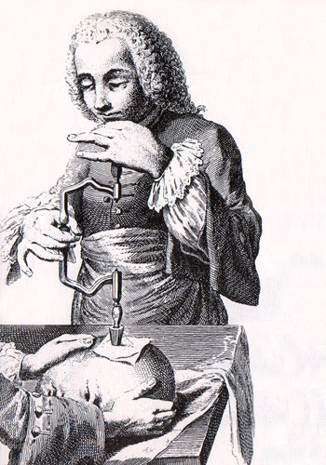
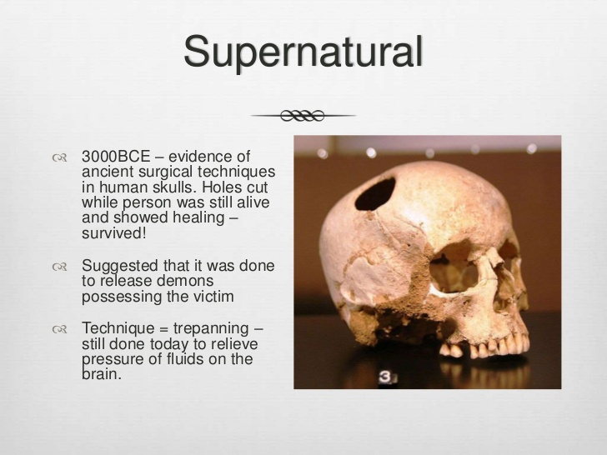
METHODS OF TREATMENT

Slide 9
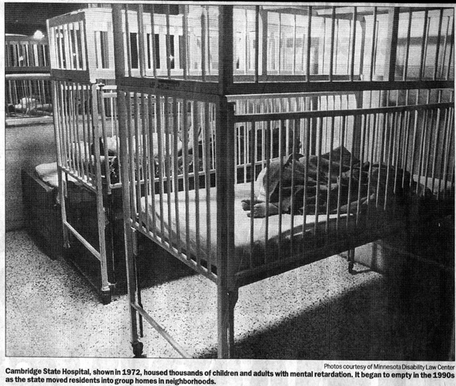
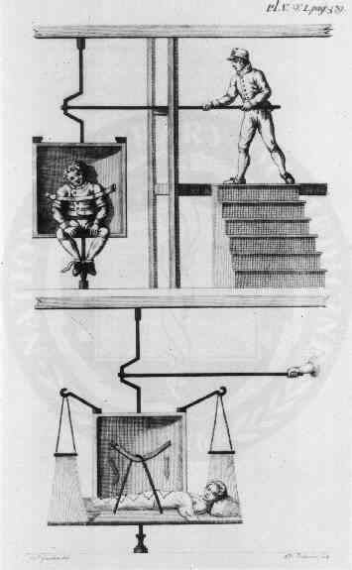

Slide 10
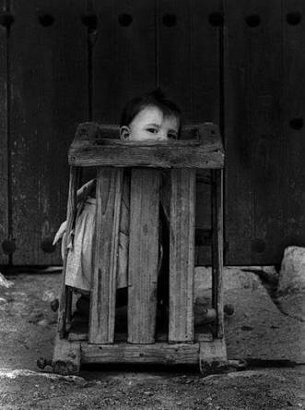
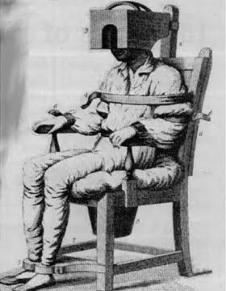
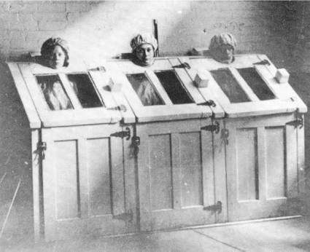

Slide 11
FACTORS UNDERLYING ABNORMAL BEHAVIOUR
BIOLOGICAL FACTORS
GENETIC FACTORS
PSYCHOLOGICAL MODELS
psychodynamic
  behavioural
  cognitive
  humanistic-existential
  SOCIO- CULTURAL MODEL
  DIATHESIS –STRESS MODEL

Slide 12
TYPES OF PSYCHOLOGICAL DISORDERS
ANXIETY DISORDER
SOMATOFORM DISORDER
DISSOCIATIVE DISORDER
MOOD DISORDER
SCHIZOPHRENIC DISORDER
BEHAVIOURAL AND DEVELOPMENTAL DISORDER
SUBSTANCE USE DISORDER

